Slide 1
Server-side Programming
Databases in Python

Slide 2
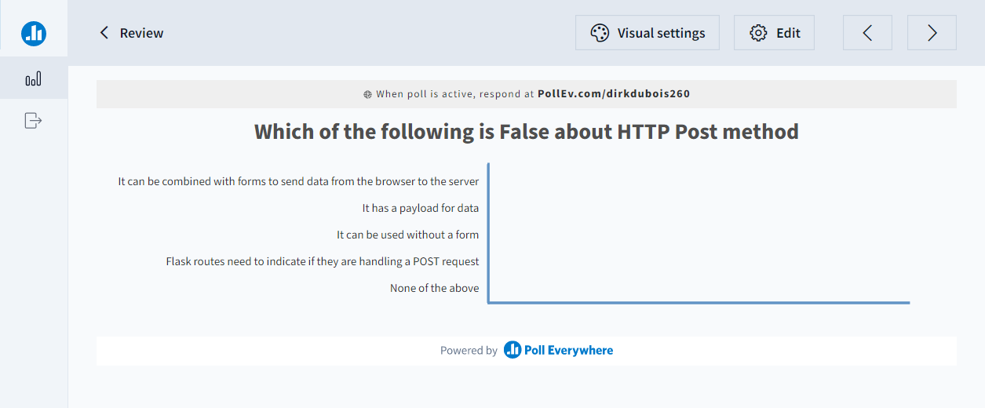
Let’s review

Slide 3
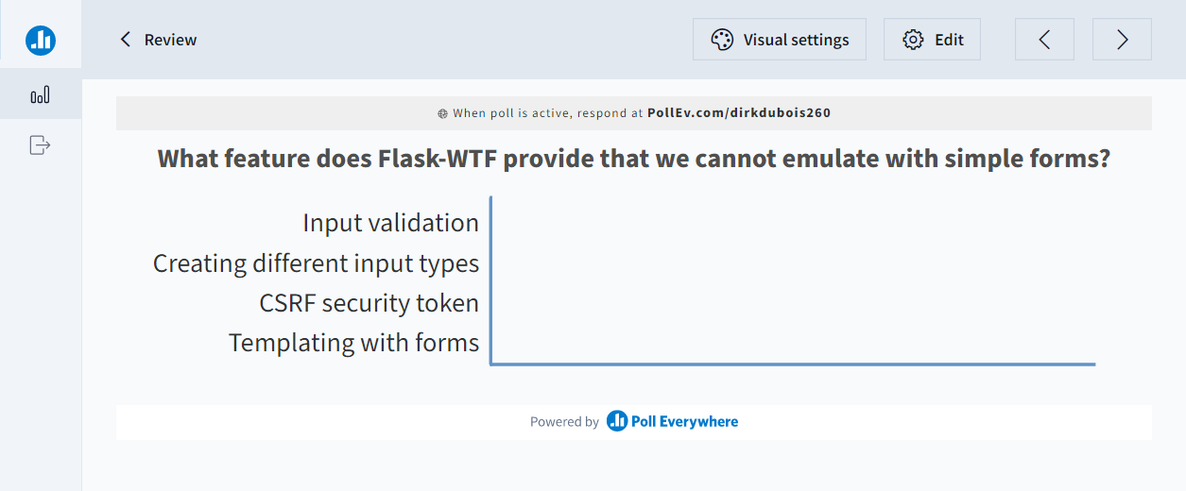
Let’s review

Slide 4
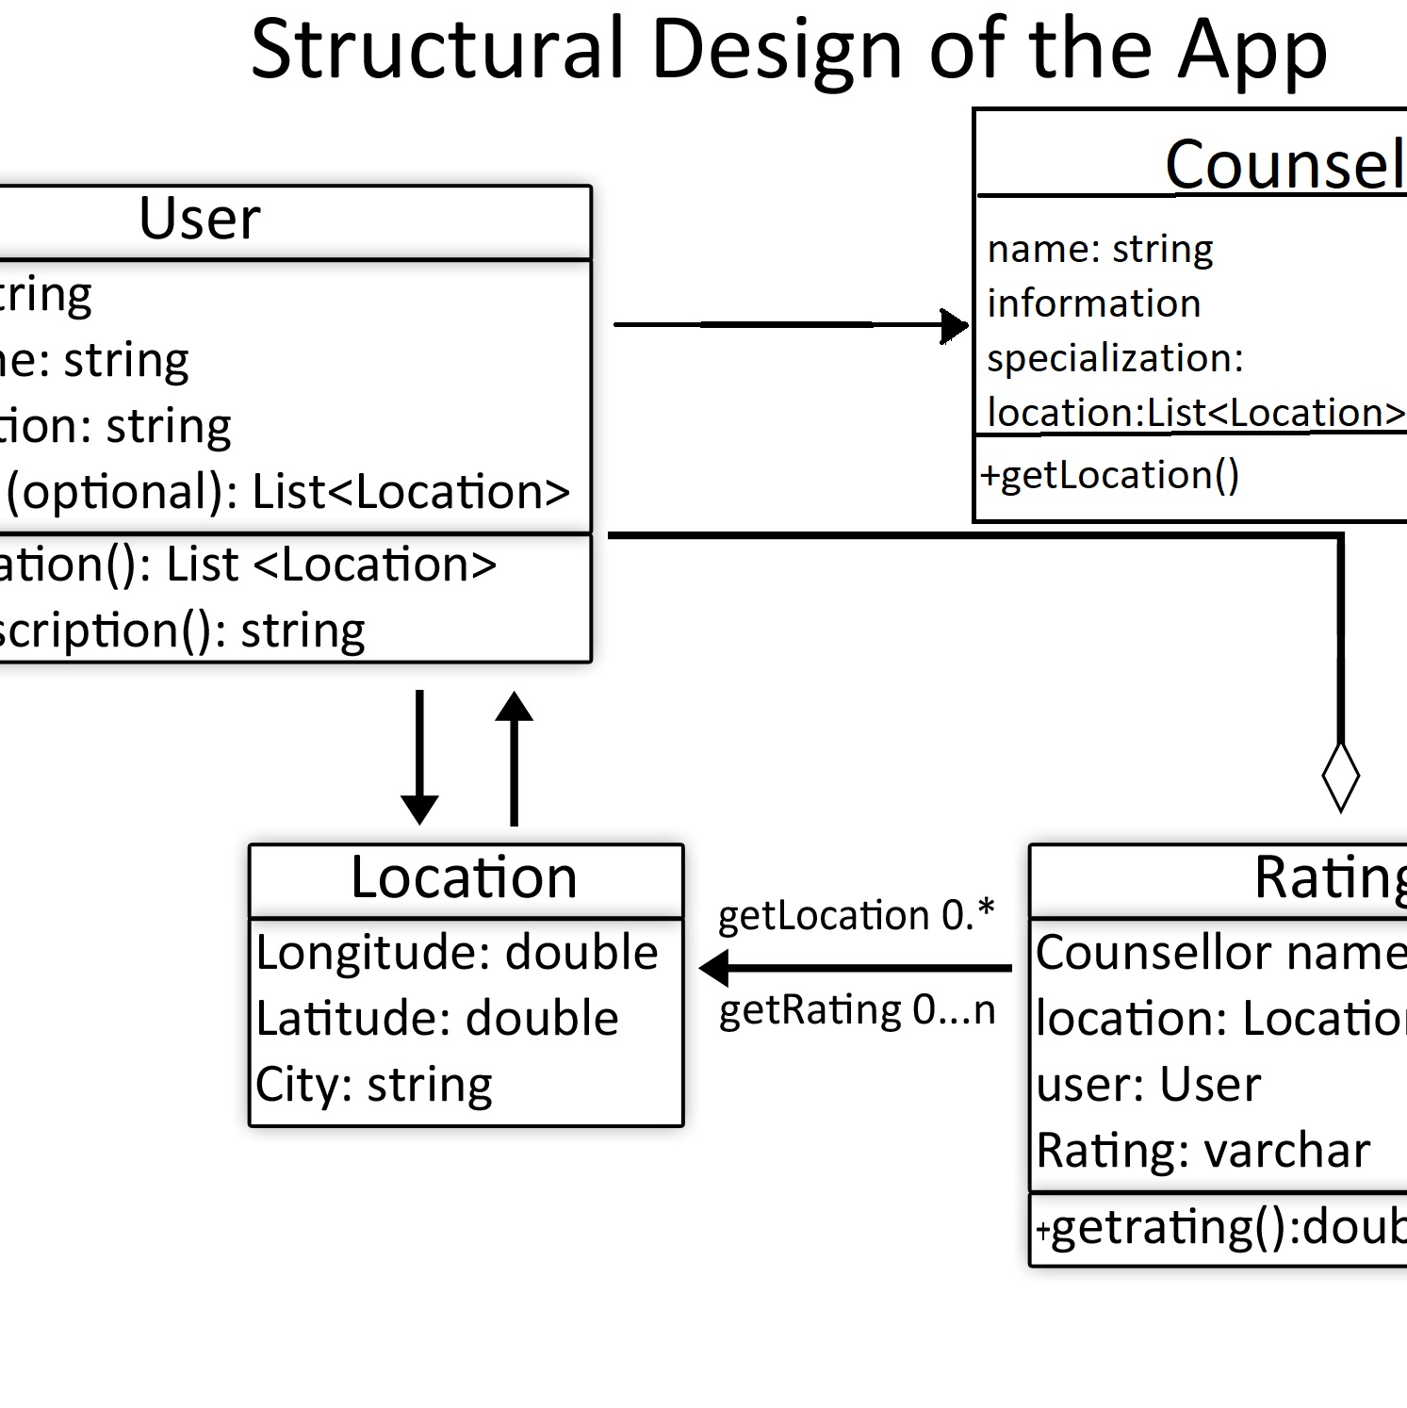


Databases are essential in most applications
Model
Persistent Storage
Scalability

Slide 5

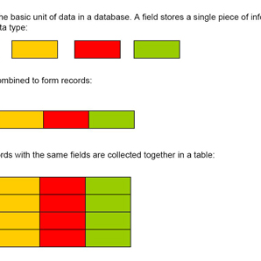
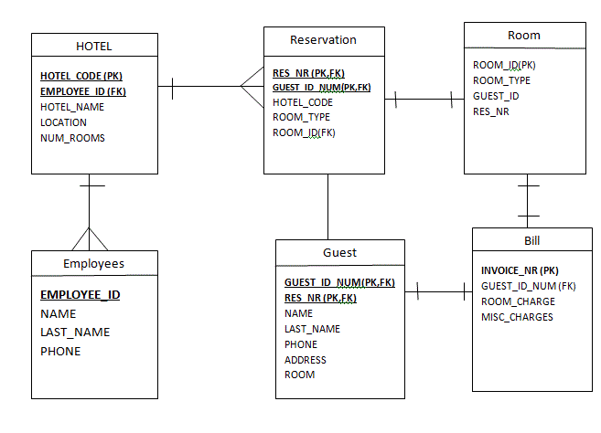
SQL interacts with relational databases
Writing Queries
Creating Tables
Describing Relationships

Slide 6
Instead of JDBC we will use oracledb
Python can communicate with databases just like any other programming language
Oracle and PDBORA19C is still the database of choice
The oracledb library in Python will allow us to connect and run queries
pip install oracledb
import oracledb
import os
conn = oracledb.connect(user=os.environ['DBUSER'],
password=os.environ['DBPWD'],
host="198.168.52.211",
port=1521,
service_name="pdbora19c.dawsoncollege.qc.ca")

Slide 7
Environment variables can be fetched using the os library
os library provides many functions for interacting with the operating system
os.environ is a dictionary of the environment variables on the system
To avoid typing in plain text the username and password for the DB it can be stored in an environment variable
import os
print(os.environ['DBUSER'])
print(os.environ['HOMEPATH'])

Slide 8
with statement in Python manages resources
Recall that objects like connections need to be closed
Similarly, cursors need to be closed
The with keyword in Python automatically closes resources at the end of scope
This is similar to try() in Java and using in C#
with oracledb.connect(user=user,
password=pwd,
host=ip,
port=1521,
service_name=service) as conn:
#Connection open
print(conn.username)
#Connection closed
print(user)

Slide 9
Interacting with DB requires a cursor
Cursors are unmanaged resources that need to be closed
Cursors provides the execute function to run queries or perform inserts
Results can be printed with a loop
with conn.cursor() as cursor:
cursor.execute("Insert into posts values (1, 'title', 'author’)”)
results = cursor.execute("select * from posts")
for row in results:
print(row[0])
print(row[1])

Slide 10
Parameters are used to substitute values in statements
Execute can take named parameters to be added to the query
This is similar to the setXXX() methods of PreparedStatements
Queries use the :var syntax for describing the parameters to be subbedd
cursor.execute("Insert into posts values (:id, :title, :author)",
id, title, author)
results = cursor.execute("select * from books where cost>:cost",
cost=20)

Slide 11
Let’s connect to PDBORA19C and get some results
Open SQLDeveloper and connect to PDBORA19C
Install oracledb in your virtual environment using pip install oracledb
Code a python file to interact with the database

Slide 12
Oracledb can throw exceptions like any other library
Oraceldb has its own set of built in errors
All errors dervive from oracledb.Error
Specific errors can be caught, e.g., IntegrityError
Recall, the server cannot crash and exceptions need to be handled correctly
try:
results = cursor.execute("select * from books where cost>:cost",
cost=20)
for row in results:
print(row[0])
print(row[1])
except oracledb.Error as e:
str(e)
try:
cursor.execute("Insert into posts values (:id, :title, :author)",
id, title, author)
except oracledb.IntegrityError as e:
print(str(e))

Slide 13
PL/SQL can be executed as well
cursor.callproc and cursor.callfunc provide functions to interact with PL/SQL
Callfunc needs to know the return type of the function
Parameters are passed as a list
create or replace function myfunc (
a_StrVal varchar2,
a_NumVal number
) return number as
begin
return length(a_StrVal) + a_NumVal * 2;
end;
…
return_val = cursor.callfunc("myfunc", int, ["a string", 15])
print(return_val) # will print 38

Slide 14
Procedures need to handle out parameters
Recall PL/SQL procedures can have in, out, or in/out parameters
When a procedure has an out parameter, Python must know what to do with it.
cursor.callproc calls procedures
cursor.var creates out variables
create or replace procedure myproc (
a_Value1 number,
a_Value2 out number
) as
begin
a_Value2 := a_Value1 * 2;
end;
out_val = cursor.var(int)
cursor.callproc('myproc', [123, out_val])
print(out_val.getvalue()) # will print 246

Slide 15
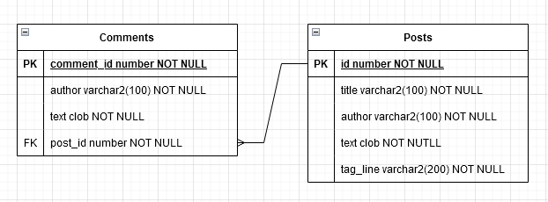
Blog posts need a database design
Posts should have an auto generated id
Comments should be connected to Posts
Correct data types need to be chosen
Recall Identity can be used to automatically generate IDs in PL/SQL

Slide 16
Let’s add a DB to our Blog App
Create a schema.sql file that creates a posts table with the correct columns
Run the file in SQLDeveloper to create the table
Modify the app.py to connect to the PDBORA19C database

Slide 17
Resources
Oracledb documentation: https://python-oracledb.readthedocs.io/en/latest/index.html
Queries: https://python-oracledb.readthedocs.io/en/latest/user_guide/sql_execution.html#fetch-methods
Exceptions: https://python-oracledb.readthedocs.io/en/latest/user_guide/exception_handling.html

